Slide 1

By: Vincent Qu, Shivani Chopra, Harry Kay & Verina Hanien

Slide 2
AGENDA
Value Proposition
Use Case
Methodology
Demo
Next Steps
Questions

Slide 3
Value Proposition
When businesses receive reviews online it’s hard to track and respond to every customer.
Our goal is to make responding to customers easy, fast and personalized.
Notes:
Verina

Slide 4






For any given business, consumer feedback exists across multiple forums...
Notes:
Shiv

Slide 5

… and reviews are integral to future consumer visits ...
53%
94%
consumers expect businesses to respond to negative reviews within 7 days
consumers state an online review has helped them avoid a business
63%
63.6%
consumers look at online reviews before visiting an establishment
consumers never receive a response
Notes:
Shiv

Slide 6
… yet businesses hardly respond.
45%
CONSUMERS WOULD RETURN TO A LOW RATED BUSINESS, DESPITE AN INITIAL NEGATIVE REVIEW, IF THE BUSINESS RESPONDED
Notes:
Shiv

Slide 7
As of 2017, there were ~ 45.17MM restaurant Reviews on Yelp, most without responses from business owners
Food was amazing! Can’t wait to come back!
Went here for my birthday. Good food, but no free cake
Slow service but good ambiance and food. Took a while for water
Awful service! Do not recommend
Typical local diner food. Ordered on UberEats- food was cold
Notes:
Shiv

Slide 8
Opportunity exists to enable direct business to consumer feedback across multiple platforms with the help of a personalized NLP plugin
Notes:
Shiv

Slide 9
Use Case
Notes:
Shiv

Slide 10



Panda Mick’s
Specializing in pandemic friendly cuisine since March, 2020

Slide 11
During the course of the pandemic, Panda Mick’s has received an eclectic score of reviews across multiple platforms
5
KNOWN PLATFORMS
1.2K+
AGGREGATED REVIEWS
Notes:
Shiv

Slide 12
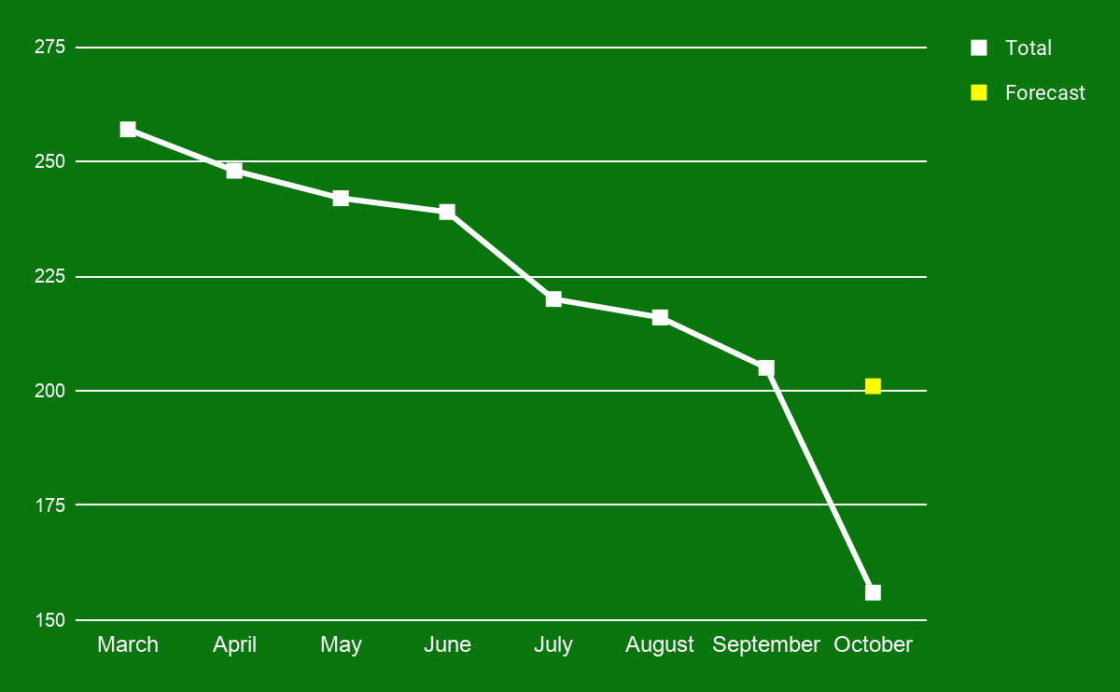
# of aggregate orders per day has steadily declined MoM, potentially due to lower ratings
Average # orders per day
Month
Notes:
Shiv

Slide 13
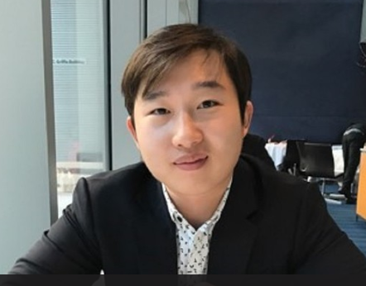
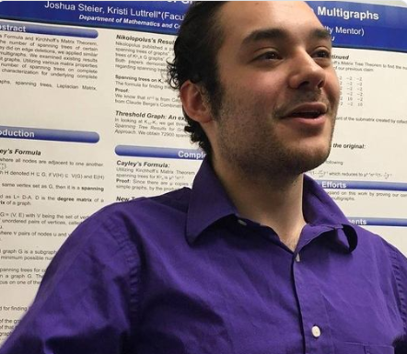

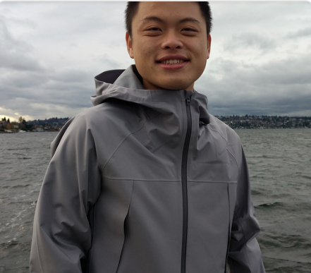
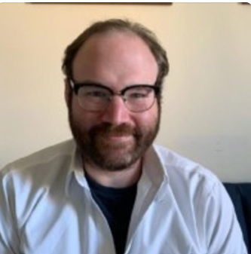

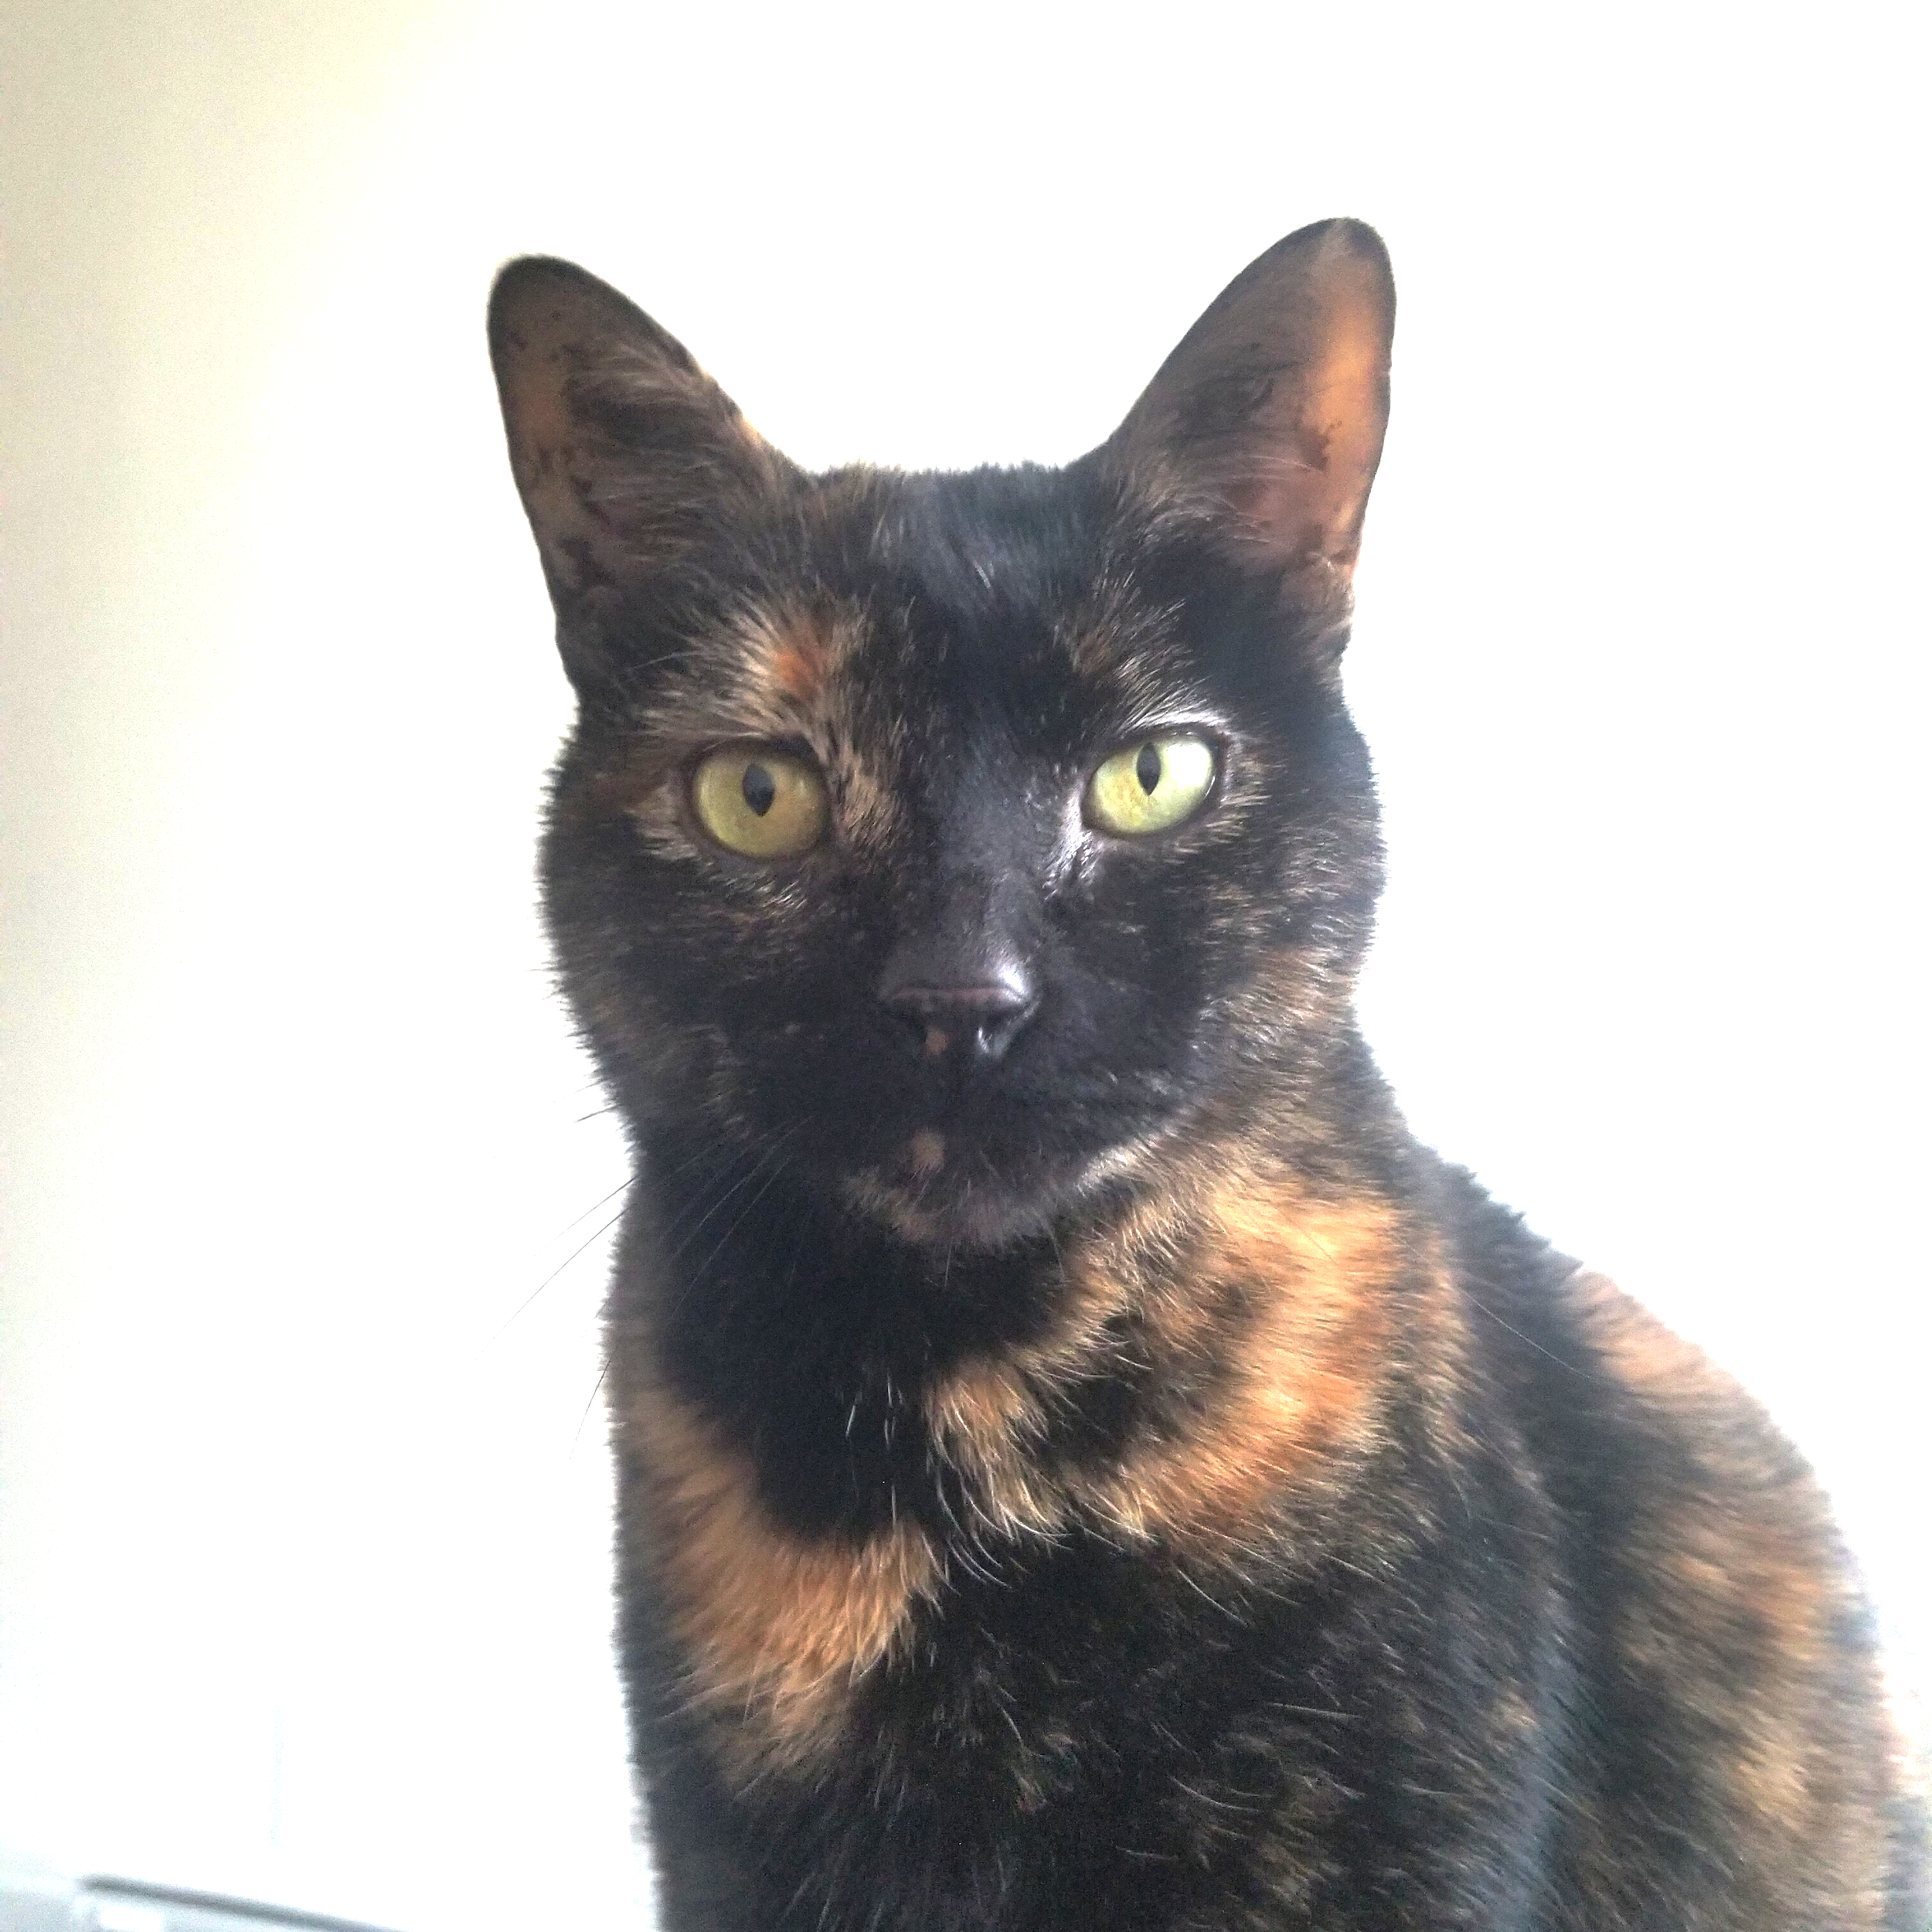




With:
Panda Mick’s barely has time to respond, let alone differentiate negative from positive reviews!
5 Sub-par Servers
4 Average Managers
2 Cute Yet
Useless Supervisors
~200*
ORDERS PER DAY
* declined from 250 orders a day in March
5+
DELIVERY & TAKEOUT PLATFORMS
Notes:
Shiv

Slide 14
Steady decline in orders may be due to lack of business response - especially towards negative reviews.
If Panda Mick’s was to implement an automated yet intuitive response system, average # of orders per day would increase since customers would feel acknowledged.
Notes:
Shiv

Slide 15
Model

Slide 16




Methodology
Train the Model
Created shell NLP code for sentiment analysis
Sampled a large YELP review dataset with 1MM reviews from Kaggle
Ensured basic sentiment was accurate; model was at 67% predictable accuracy
Personalize it
Developed list of responses, ranging from very positive (5 stars) to abysmal (1 star)
Produced list of variables, specific to Panda Mick’s (i.e. server names, delivery services, etc)
Enhance the Model
Joined the model with personalized variables and response types based on predicted star rating
Test it
Created 5 sample responses and ensured model had predicted expected star rating & personalized responses
Notes:
Shiv

Slide 17
Demo

Slide 18
Test Cases
Scenario 1
Scenario 2
Feedback: I loved this restaurant! Our servers were great, and very responsive to our needs. My wife and I went there for our 10th anniversary, and we will be recommending the experience to our friends.
Feedback: What a lousy joint. The food was undercooked and mealy. I wouldn’t go there if you paid me. The restaurant was dirty, and during Covid, that is a major concern for my family. Go there at your own risk.
Generated response: We’re glad we could be a part of your special day! Congratulations on your anniversary.
Generated response: We assure you that Panda Mick's is taking all precautions. We apologize that we were not up to par during your visit. Please give us another chance to provide a better experience.
Notes:
Shiv

Slide 19
Test Cases (cont’d)
Scenario 3
Scenario 4
Feedback: Just got my order from UberEats, and it was super fast. The food was good, especially the beignets, but some of it was a little damaged and they did not bring enough sauce. More sauce, please!
Feedback: I was mostly happy with my meal. My sister’s samosas were cold, as the service was a little slow. I would go there again and try something else.
Generated response: Thank you for your response about your order. We are working with UberEats and we are both improving every day.
Generated response: We’re glad you enjoyed your meal! We are continuing to work on improving your service experience.
Notes:
Shiv

Slide 20
Test Cases (cont’d)
Scenario 5
Feedback: I went to Panda Mick’s for dinner yesterday, and I will not be going back. Our server was very nice, but overwhelmed. There was a smell, and I don’t think that the restaurant was as clean as I would like. Your mileage may vary, but you can’t say I didn’t warn you.
Generated response: We assure you that Panda Mick's is taking all precautions. We apologize that we were not up to par during your visit. Please give us another chance to provide a better experience.
Notes:
Shiv

Slide 21
Next Steps
Survey market and competitively price our product
Market
Train our model to work for industries beyond restaurants
Enhance
Implement our responses live on review websites
Implement

Slide 22
Questions?
Notes:
Verina

